Slide 1



Analysis of Infant Mortality Rate(IMR) in Relation to Medical Personnel in Asian Countries
Zhuoya Wang
07/29/2024

Slide 2
Introduction
01
Brief overview of Infant Mortality Rate
02
Dataset Overview
03
Purpose

Slide 3
Infant Mortality
Definition: Infant Mortality Rate (IMR) refers to the number of deaths of infants under one year old per 1,000 live births in a given year.
Significance: IMR is a critical indicator of a country's overall health status, reflecting the social, economic, and environmental conditions in which children (and others in society) live, including their healthcare.
Causes: Preterm Birth Complications, Infections, Birth Asphyxia, Congenital Abnormalities, Nutrition and Feeding Problems and etc.

Slide 4

Datasets Overview
Infant Mortality Rate (IMR) Dataset: This dataset contains the country, year and the Infant Mortality Rate (IMR) data, which is the number of deaths of infants under one year old per 1,000 live births.
Medical Doctors Dataset: This dataset includes the number of medical doctors per 1,000 people in various countries
Nursing and Midwifery Personnel Dataset :This dataset provides the number of nursing and midwifery personnel per 1,000 people.
Pharmacists Dataset: This dataset contains information about the number of pharmacists per 1,000 people in various countries

Slide 5

Merged Dataset
Merged Dataset:
The datasets were merged based on Country and Year to create a comprehensive dataset that includes IMR and the number of medical doctors, nursing and midwifery personnel, and pharmacists.
This merged dataset allows for a comprehensive analysis of the relationships between IMR and the availability of healthcare personnel across different countries and over multiple years.

Slide 6
Purpose
The purpose of this task is to analyze the relationship between Infant Mortality Rate (IMR) and the availability of healthcare personnel (doctors, nurses, midwives, and pharmacists) across various Asian countries.
The goal is to identify the key factors influencing infant mortality and to predict future trends so that targeted interventions can be effectively implemented to reduce infant mortality.

Slide 7
Forecast & Analysis

Slide 8

Methodology:
Dashboard
Modeling Technique
Performance Evaluation
Comparison with the actual data
Dashboard of geographical heat maps per variable was created by Shiny App
Time Series and Log Difference transformation was applied for forecasting.

Slide 9

Dashboard: Geographical heat maps
The Dashboard provides an interactive interface to visualize geographical heatmaps for various health sector variables, including the number of doctors, nurses, midwives, pharmacists, and the Infant Mortality Rate (IMR).
Users can select a variable and year to explore the data through a dropdown menu and a slider. The color scale indicates the range of values, with brighter colors representing higher values.

Slide 10
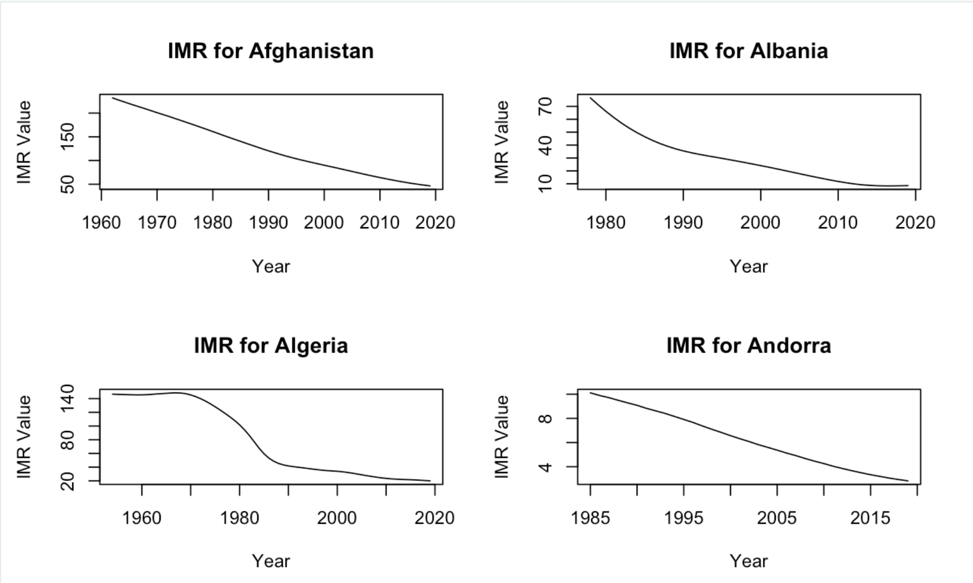

Modeling Techniques:
Problem: Non-Stationary Data
Data that shows trends, seasonality, or other structures over time is termed non-stationary.
Infant Mortality Rate (IMR) data exhibits non-stationarity over time and country.
Solution: Log Differences Transformation
Log transformation stabilizes the variance in the data.
Differencing the log-transformed data helps to remove trends and make the data stationary.

Slide 11
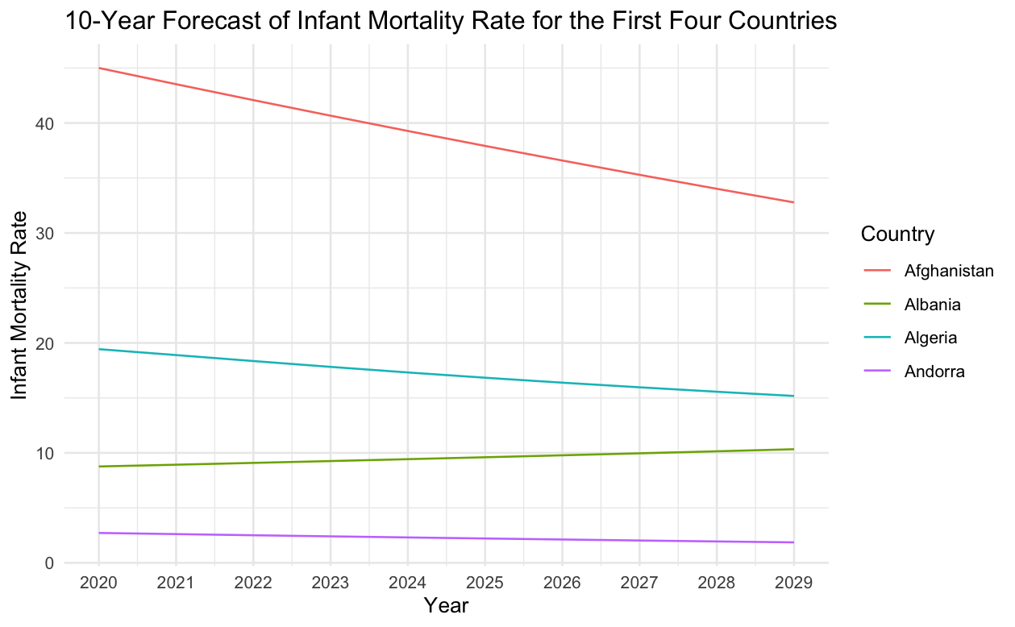

Forecast Result: Insights from Four Countries
Afghanistan:
The forecast shows a steady decline in the IMR over the next 10 years.
The IMR starts at approximately 43 and decreases to around 35 by 2029.
Albania:
IMR remains relatively stable over the forecast period.
The rate fluctuates slightly around 10.
Algeria:
The forecast indicates a gradual decline in the IMR.
The IMR starts at about 19 and decreases to around 16 by 2029.
Andorra:
IMR is consistently low and stable and remains close to 0.

Slide 12

Forecast Result: Comparison & Analysis
Accuracy:
The overall trend and IMR values are generally close, with minor deviation from the actual values.
Discrepancy:
Minor discrepancies in the forecasted IMR values may be due to unforeseen changes in healthcare policies, economic factors, or external events impacting infant mortality.
Continuous monitoring and model adjustments are recommended to improve forecast accuracy over time

Slide 13
Discussion
Insights:
The forecasts revealed significant temporal trends, reflecting ongoing improvements in healthcare infrastructure, economic conditions, and public health policies in many countries.
These forecasts are crucial for policymakers to plan and allocate resources effectively to areas where IMR is projected to remain high or decrease slowly.
Limitations:
The accuracy of the forecast relies heavily on the quality and completeness of the historical data. Any inconsistencies or missing data can significantly impact the reliability of the predictions.
Forecasting beyond the available data period involves extrapolation, which carries inherent risks. The farther the forecast extends into the future, the greater the uncertainty and potential for error.
Recommendations:
Regular updates (Update the model regularly with the latest data to ensure accuracy and relevance)
Scenario Analysis (consider changes in external factors)

Slide 14
Regression &
Analysis

Slide 15

Methodology:
Data Processing
Modeling Technique
Performance Evaluation
Model's effectiveness was evaluated using R-Square, RMSE, MAE and diagnostic plots for models.
A comprehensive dataset was made to analyze the relationship.
Only IMR values with Both Sexes were filtered as response variable
Dataset was splited
Linear regression was used to model the relationships.
Model selection implied.

Slide 16
Evaluation Methods:
M₁
Adjusted R-squared:
Provides a accurate measure of goodness of fit
Higher values indicate a better fit
M₂
Root Mean Square Error(RMSE)
Gives a measure of the average magnitude of the error in the same units as the response variable
Lower values indicate better model performance
M₃
Mean Absolute Error (MAE)
the average of the absolute difference between predicted and actuarial values
Lower values indicate better model performance
M₄
Residual Diagnosis:
Diagnostic plots help identify potential issues such as non-linearity, heteroscedasticity and influential data.

Slide 17

Model Performance (without Year and Country)
The encountered significant issues due to multicollinearity among the predictors, resulting in the inability to estimate the coefficients for Doctors_Value, Nursing_Value, and Pharmacists_Value, which were all returned as NA.
Results indicate that these variables are highly correlated and not sufficiently independent, causing singularities in the regression matrix.
The residual standard error of 49.92 suggests a considerable spread of residuals, further indicating a poor model fit.

Slide 18

Model Performance (with Year and Country)
Adjusted R-squared: 0.8882
indicates that approximately 88.82% of the variability in the Infant Mortality Rate (IMR) can be explained by the predictor variables in the model.
This high value suggests that the model has a good fit and that the predictors are collectively effective in explaining the variations in IMR.
RMSE: 16.49
The Root Mean Square Error (RMSE) value of 16.49 indicates the average deviation of the predicted IMR values from the actual values.
A lower RMSE indicates better model performance. This value suggests that the model predictions are, on average, 16.49 units away from the actual IMR values.
MAE (Mean Absolute Error): 12.09
Average absolute difference between predicted and actual values.
Indicates that, on average, the model's predictions are 12.09 units away from the actual IMR values.

Slide 19

Variable Importance & Discussion
Mselection based on AIC:
The final regression model includes only two predictor variables: Country and Year, indicating these two variables are the most significant predictors of the Infant Mortality Rate (IMR) in the dataset.
We have a similar performance matric even after removing variables due to singularity issues, and this happens for serval reasons:
Dominance of Remaining Predictors
Multicollinearity

Slide 20
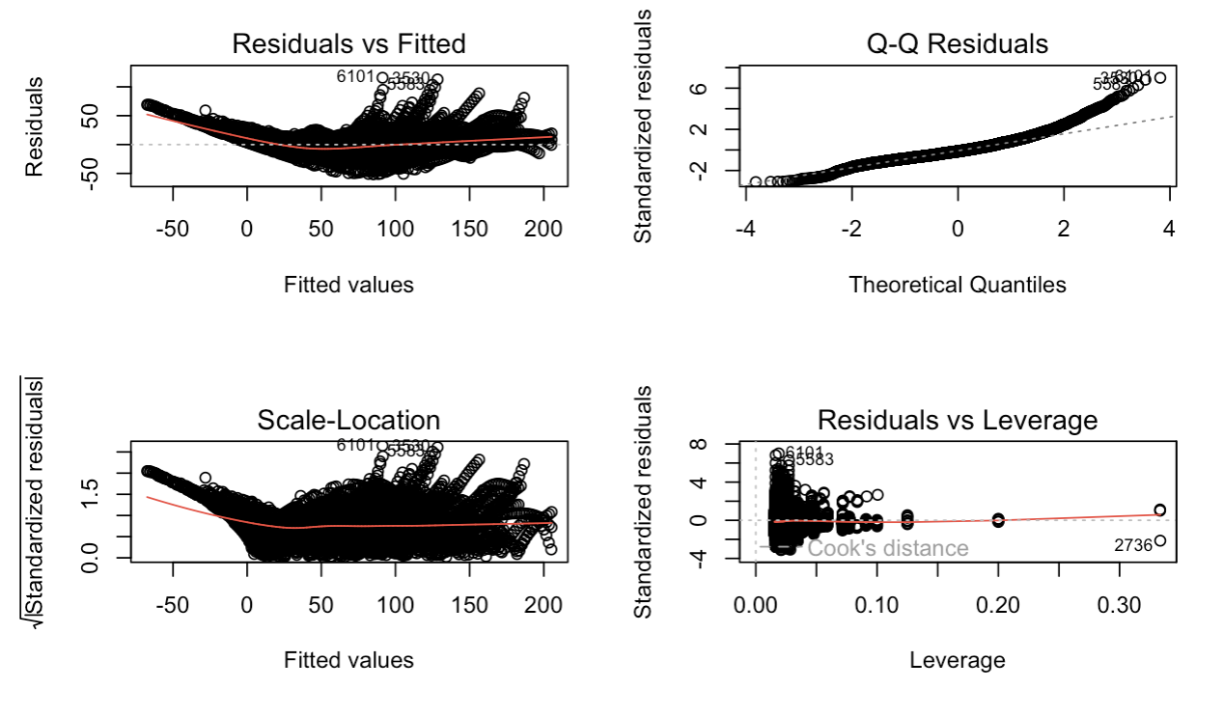
Visualization: Diagnostic Plots
Non-linearity: The linear model does not capture the relationship between the predictors and IMR adequately.
Non-normality: The residuals are not normally distributed, which can affect hypothesis testing and confidence intervals.
Heteroscedasticity: The variance of the residuals is not constant, violating one of the key assumptions of linear regression.
Influential Points: High leverage points suggest that some data points disproportionately affect the model's estimates.

Slide 21

Conclusions:
Despite good performance metrics, the poor diagnostic plots indicate that the linear regression model does not fit the data well.
The discrepancies between the metrics and the diagnostic plots suggest that the model's assumptions are violated, leading to unreliable estimates and predictions.
Numerous (interaction) terms are explaining the response variable, leading to a larger adjusted R-square, small RMSE and MAE for a model. This might be the reason of good performance metric.

Slide 22
Discussion
Insights:
Long-term improvements in healthcare systems and policies tailored to individual countries. Monitoring and addressing IMR requires continuous efforts to enhance healthcare access, quality, and socio-economic conditions over time.
The importance of country-specific factors such as healthcare infrastructure, economic conditions, and policies should be highlighted.
Limitations:
Multicollinearity :Persistent multicollinearity among initial predictors led to singularities, making it challenging to estimate the individual contributions of medical personnel variables such as doctors, nurses, and pharmacists.
Recommendations:
Explore Non-linear Models (polynomial regression, generalized additive models (GAM))
Use Robust Regression Techniques(weighted least squares)
Investigate High Leverage Points( influential data points identified in the residuals vs. leverage plot)

Slide 23
Thank You !
Zhuoya Wang
07/29/2024

